Slide 1
2026
Annual General Meeting
Bassin versant du Lac Heney Watershed
Location: Lac-Sainte-Marie Community Centre, 2nd floor
10-B rue du Centre, Lac-Sainte-Marie
Sunday, July 19, 2026

Slide 2
Agenda – Bassin versant du Lac Heney
Registered as the Association for the Protection of Lac Heney
Association – President’s report Tony VanDuzer
Nominating Committee Tom McKenna
Association Financials Ted Billey
Mining Exploration Update Chantal Landry
Science Committee
  Community Outreach
    Wildflowers/Shoreline Protection Chantal Landry
  State of the Lake Tom McKenna
  Eurasian Milfoil Update Tom McKenna
Bay Captains Relaunch Jane Macintyre/
Ashwin Shingadia

Slide 3
President’s Report
Major activities in 2025-26
Science & Environment Committee
  Monitoring – phosphorus, oxygen
  Eurasian Milfoil Working Group
  Community Wildflower Program
Communications
  Two on-line newsletters
  Bulletins on key issues – e.g. elections – not just lost docks
  FB Group – Friends of Lac Heney | Les Amis de Lac Heney – over 540 members
Municipal relations
  Meetings with MRC de la Vallée de-la-Gatineau, Municipalité de Lac-Sainte-Marie, Ville de Gracefield

Slide 4
President’s Report
Major activities in 2025-26 (ii)
Board Renewal
  Retirements from our board this year
    Karen Richardson – led the Association’s Milfoil Working Group
    Russell Dewitt – member of the Milfoil Working Group
  New directors
    Arleigh McCurdy
    Matthew Rinfret
Supplementary Letters Patent filed – new name and objects
  Association du Bassin versant du Lac Heney
Fall Retreat
New mission statement adopted

Slide 5
New Mission Statement - Long Version
The Bassin versant Lac Heney Watershed Association is dedicated to protecting and conserving the Lac Heney watershed for the benefit of waterfront property owners now and in the future. By promoting the sustainability of the watershed lakes, the Association seeks to safeguard the many kinds of value that waterfront property has for its owners.
To achieve that goal, the Association
(1) monitors water quality in the watershed lakes and responds to concerns of Association members regarding the watershed lakes,
(2) provides information to Association members and other users of the watershed regarding what they can and should do to protect the watershed,
(3) takes action to address threats to the watershed, including with the help of government programmes that provide support, and
(4) advocates for the development and enforcement of policies, laws, and regulations to protect the Lac Heney watershed and the surrounding environment, including through shoreline management and septic system maintenance with Gracefield, Lac-Ste-Marie, the MRC, and the province.

Slide 6
New Mission Statement - Short Version
The Bassin versant Lac Heney Watershed Association is dedicated to protecting and conserving the Lac Heney watershed for the benefit of waterfront property owners now and in the future through education, direct action, and advocacy. By promoting the sustainability of the watershed lakes, the Association seeks to safeguard the many kinds of value that waterfront property has for its owners.

Slide 7
Priorities for 2026-27
Eurasian Milfoil Strategy
Bay Captain’s Program Re-launch
Membership Growth
Kiosk Restoration
Board Renewal and President Search
  Association needs new directors and new leadership
    Interested in the issues that affect your lake and your property?
    Curious to learn more about the board and how you can make a difference?
Looking for volunteers from the membership to help out with Milfoil Working Group, Newsletter, and Kiosk repairs
Please let me or any of our directors know if you are interested in any of these opportunities or know someone who might be
javanduzer@gmail.com

Slide 8
Association Nominating Committee Report
Board of Directors for 2026/27
Directors Lake First Elected Term Ending Roles Jane Macintyre Heney 2024 2027 FaceBook Admin, Bay Captains
Diane Billey Heney 2019 2027 Secretary, Merchandise
Chantal Landry Desormeaux 2019 2027 Environment, Community
Sean Sutton Desormeaux 2017 2027 Communications
Tony VanDuzer Heney 2021 2027 President, Legal
Michael Wolfson Heney 2015 2027 Environment
Peter Paciorek Heney 2026 2027 Membership
Standing for Re-Election
Tom McKenna Heney 2004 2026 Environment
Ashwin Shingadia Heney 2012 2026 Bay Captains
Liz Stirling Heney 2020 2026 Communications
Ted Billey Heney 2018 2026 Treasurer
The President Tony VanDuzer is standing for election in 2026

Slide 9
Nominating Committee: Motions
Tom Mckenna
The President is elected by the Members at the AGM, from the Board of Directors
The Board is composed of not fewer than 8 or more than 20 Directors
Moved by Nominating Chair, Tom McKenna:
To elect Tony VanDuzer as President standing for re-election for a one-year term ending in 2027
To elect the Directors standing for re-election in 2026 for two-year terms ending in 2028
  Tom McKenna Ashwin Shingadia Ted Billey
  Tony VanDuzer Liz Stirling Peter Paciorek
To elect new directors for a two-year term ending in 2028
  Name: Arleigh McCurdy
  Name Matthew Rinfret
Moved by TMcK Seconded by ________All in Favour_________
We encourage representation from all watershed lakes!
We encourage diversity on our Board!

Slide 10
Association Financials
Ted Billey
Ted Billey, Treasurer
    Income Statement for May 1, 2025 to April 30, 2026
    Budget for May 1, 2026 to April 30, 2027
Accounting Review Committee: Tony VanDuzer and Diane Billey
    Accounting review conducted July 9, 2026
    All transactions were supported by the appropriate invoices / documents
    No anomalies were found.
Association Financials: Motions
    Accounting review
    Income Statement
    Budget

Slide 11
Income Statement – May 1, 2025 to April 30, 2026
May 1, 2025 to April 30 2026 - Revenues
 | Membership Revenues ( 108 paid members ) | $ 5,241.30
 | Merchandise Revenue | $ 1,549.35
 | Donations ( BBQ & Other ) | $ 330.00
 |  |  | $ 7,120.65
May 1, 2025 to April 30 2026 - Expenses
 | Wildflower Expenses | $ 57.05
 | Board Meeting / Retreat at RA Center | $ 403.47
 | Insurance | $ 1,097.68
 | Quebec Bus registry fees | $ 529.94
 | Milfoil Expenses | $ 181.09
 | BBQ | $ 685.55
 | Newsletter Expenses | $ 500.00
 | Buoy Replacement | $ 212.38
 | Kiosk Mtc & Repair | $ 435.05
 | Website costs / WordPress Charges | $ 447.48
 | Merchandise Expenses | $ 2,535.45
 |  |  | $ 7,085.14
May 1, 2025 to April 30 2026 - Net Gain / ( Deficit ) |  |  | $ 35.51
Balance of Association TD Bank Account on FYE April 30, 2026 |  |  | $ 25,399.50
Notes:
This income Statement was approved by the Board on May 13, 2026
The association presently has Merchandise Inventory on hand with a wholesale value of $6,389.41

Slide 12
Budget May 1, 2026 to April 30, 2027
2026 / 2027 Expected Revenues
 | Membership Revenue | $ 5,324.40
 | Donation at AGM & BBQ ( based on previous year ) | $ 300.00
 | Merchandise Revenue | $ 1,500.00
 | Total Revenue |  | $ 7,124.40
2026 / 2027 Expected Expenses
 | AGM & BBQ | $ 1,000.00
 | Association REPVG Dues ( for 1 year ) | $ 100.00
 | Board meeting expenses | $ 200.00
 | Insurance | $ 1,097.68
 | Kiosk Maintenance / Repair | $ 500.00
 | Legal Fees (Supplementary Letters Patent) | $ 1,216.75
 | Website Maintenance | $ 540.00
 | Bay Captain thank you Gift | $ 250.00
 | Newsletter Expenses | $ 250.00
 | REPVG Donation | $ 500.00
 | Quebec Business Registry fee | $ 60.00
 | Milfoil Buoy Deployment | $ 1,000.00
 | Science Committee Gas expenses | $ 100.00
 | Website Hosting | $ 447.48
 | Wildflower Initiative & Shoreline Protection | $ 300.00
 | Total Expense |  | $ 7,561.91
2026/27 Net Gain / (Deficit) |  |  | $ (437.51)
Notes:
  This budget was approved by the Board on May 13, 2026

Slide 13
Association Financials: Motions
The financial statements were independently reviewed on July 9, 2026 by the Accounting Review Committee (Tony VanDuzer and Diane Billey) and were found to be accurate in all material respects
  Moved that the independent review by the Accounting Review Committee is approved by the Members;
    Moved by _____________, Seconded by _____________,
    All in favour __________
  Moved that the Income Statement – May 1, 2025 to April 30, 2026 as prepared by the Treasurer and approved by the Board of Directors on May 13, 2026 be accepted as presented.
    Moved by ____________, Seconded by ______________,
    All in favour __________
  Moved that the Budget – May 1, 2026 to April 30, 2027 as prepared by the Treasurer and approved by the Board of Directors on May 13, 2026 be accepted as presented.
    Moved by ____________, Seconded by ______________,
    All in favour __________

Slide 14
Mining Exploration Update
STATUS OF CLAIMS HELD BY BRUNSWICK EXPLORATION
June 4, 2026: Expiration of the majority of claims held by Brunswick Exploration.
June 13, 2026: Claims in the far south of Lac Vert held by Brunswick Exploration have expired, but retain the right to acquire and explore for any interested party, due to their registration in the Quebec Mining Rights Register created in 1988 and exploration investment since that date. These claims are subject to the former Mining Act, which encouraged free mining.
Limited recourse for landowners against these claims: right to refuse exploration and lack of public acceptance.
One-kilometer protection zone from the private property line
Given the large number of properties and the lack of follow-up after exploration investments, this possibility remains unlikely.
August 29, 2026: Expiration of two Brunswick claims near Lac Vert if no exploration investments are made by that date.

Slide 15
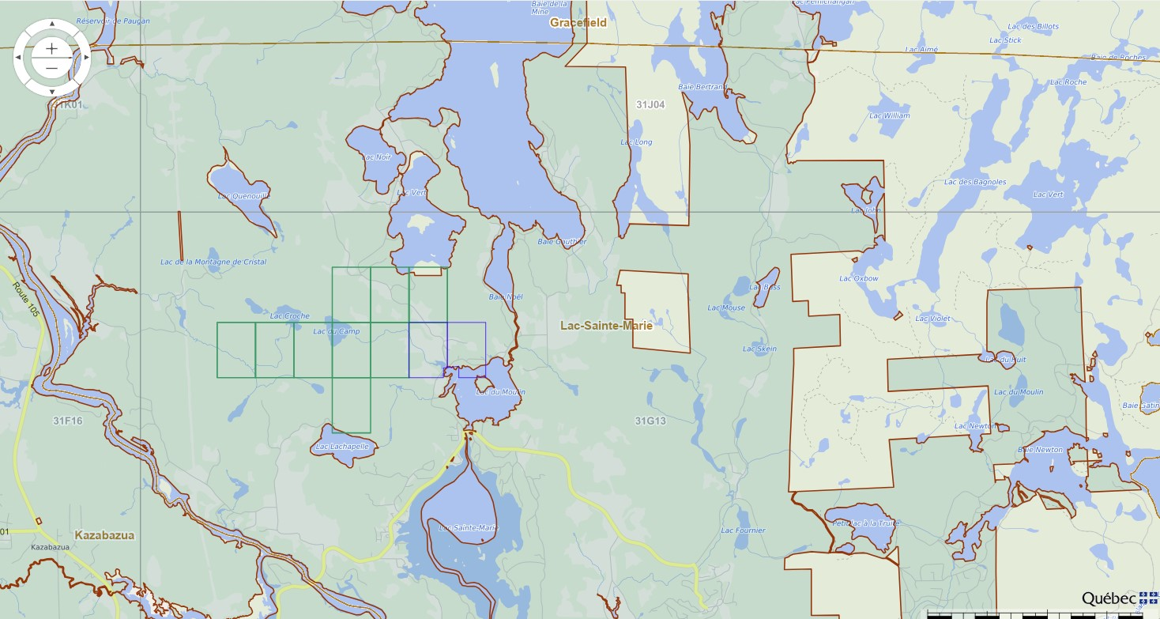
Mining Exploration Update

Slide 16
Science & Environment Committee
WILDFLOWERS/SHORELINE PROTECTION
Distribution of wildflower seeds and information in Lac-Sainte-Marie and Gracefield
A successful fourth year in a row! We received many thanks and congratulations from waterfront property owners and the mayor of Lac-Sainte-Marie for this initiative.
Seeds of two milkweed species were distributed: swamp milkweed (Asclepias incarnata) and common milkweed (Asclepias communis) for planting along the shores of our lakes, to improve the watershed ecosystem. These are the only plants that allow the Monarch butterfly to reproduce, a species whose population has declined by 90% and is therefore very close to extinction.
Information was also provided on the new provincial regulations adopted (March 1, 2026) aimed at ensuring greater protection of the ecological functions of shores, littorals, floodplains zones. Implementation of these regulations is delegated to the municipalities.

Slide 17
Science & Environment Committee
WILDFLOWERS/SHORELINE PROTECTION
Distribution of wildflower seeds and information (ii)
In aquatic environments, new rules apply to prohibited activities, some activities require permits or certain conditions to be met, and there can be penalties. For example, a permit is required:
    to create a visual opening at the shore, which must not exceed 5 meters or 10% of the shore length, including existing openings; the remaining shore, which is 10 or 15 meters deep (calculated from the high-water mark), must be entirely planted with native species;
    to create access to a lake;
    to build a dock, which must not exceed 30 square meters.
It is important to check with your municipality before undertaking any work on your property or the lake shore to find out about the regulations that apply in your area.

Slide 18
Science & Environment Committee
WILDFLOWERS/SHORELINE PROTECTION
Importance of Natural Shore Vegetation
Maintains and improves water quality and the health of our lakes when preserved in its natural state. Its essential role includes:
  A barrier against soil and shoreline erosion
  A filter against water pollution
  A barrier against debris, sand, mud, rocks, and other solid matter entering the lake
  Acts as a regulator of the water cycle as the rain and snow replenish our lakes, streams, rivers, the soil and groundwater
  A habitat for fauna and flora
  A food source for wildlife, pollinating insects, and birds
  A buffer against excessive water warming by creating shaded areas
  A natural windbreak.
To revegetate the shore of your property, plant native plants adapted to the wetter soil along the lake.

Slide 19
Science & Environment Committee
WILDFLOWERS/SHORELINE PROTECTION
Conservation of Wildflowers Along Roadsides
We have submitted a request to both municipalities to preserve the natural flora along roadsides and in ditches. Why preserve this vegetation?
  To improve the watershed ecosystem and allow these plants to reproduce, particularly on the shores of lakes and other waterways in our region,
  Excellent for pollinators, birds, and the watershed ecosystem
  Act as a barrier between roads and lakes by capturing dust and carbon
  Prevent road runoff during heavy rains and spring snowmelt (we are currently experiencing this at Lake Desormeaux)
  Beautify the road network
  Allow wild plants in ditches to reproduce and restore and protect lake shores
  Enhance the municipality's image, demonstrating its commitment to nature conservation.
  Help reduce costs for the municipality.
Does not obstruct visibility on curves and does not prevent roadside parking.
This proposal will be submitted to the municipal councils.

Slide 20
Science & Environment Committee
State of the Lake
State of the Lake: July 2026
Tom McKenna

Slide 21
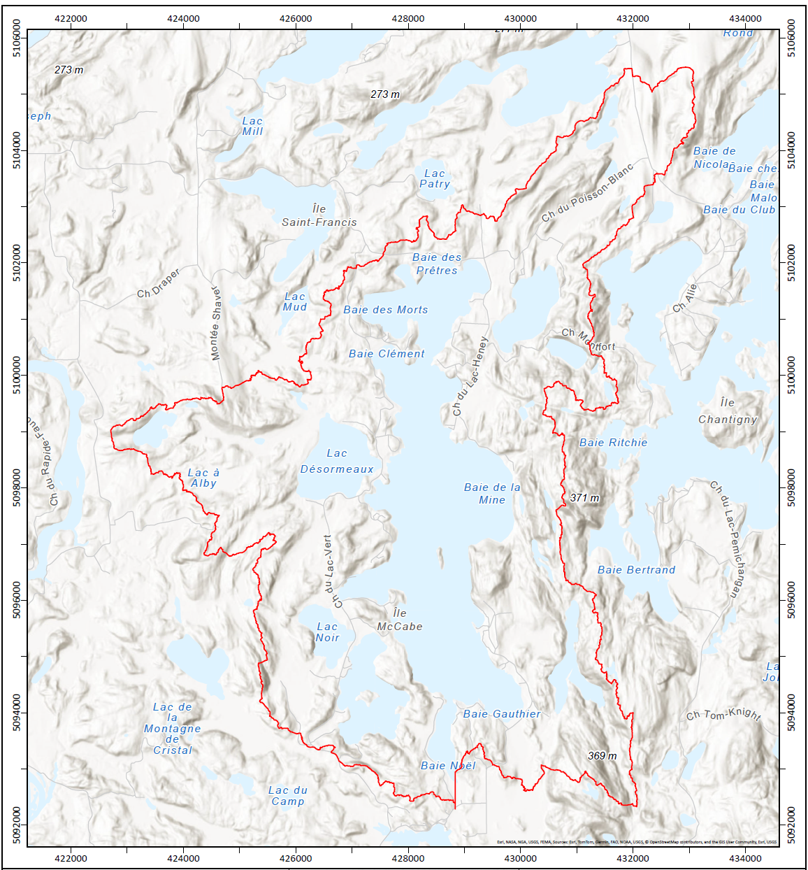
Bassin versant du Lac Heney
Côté Gracefield
Lac à la Barbue
Lac Desormeaux
Lac du Chat Sauvage
Lac Ruglis
Côté Lac-Sainte-Marie
Lac Vert
Lac Noir
Lac Long
21

Slide 22
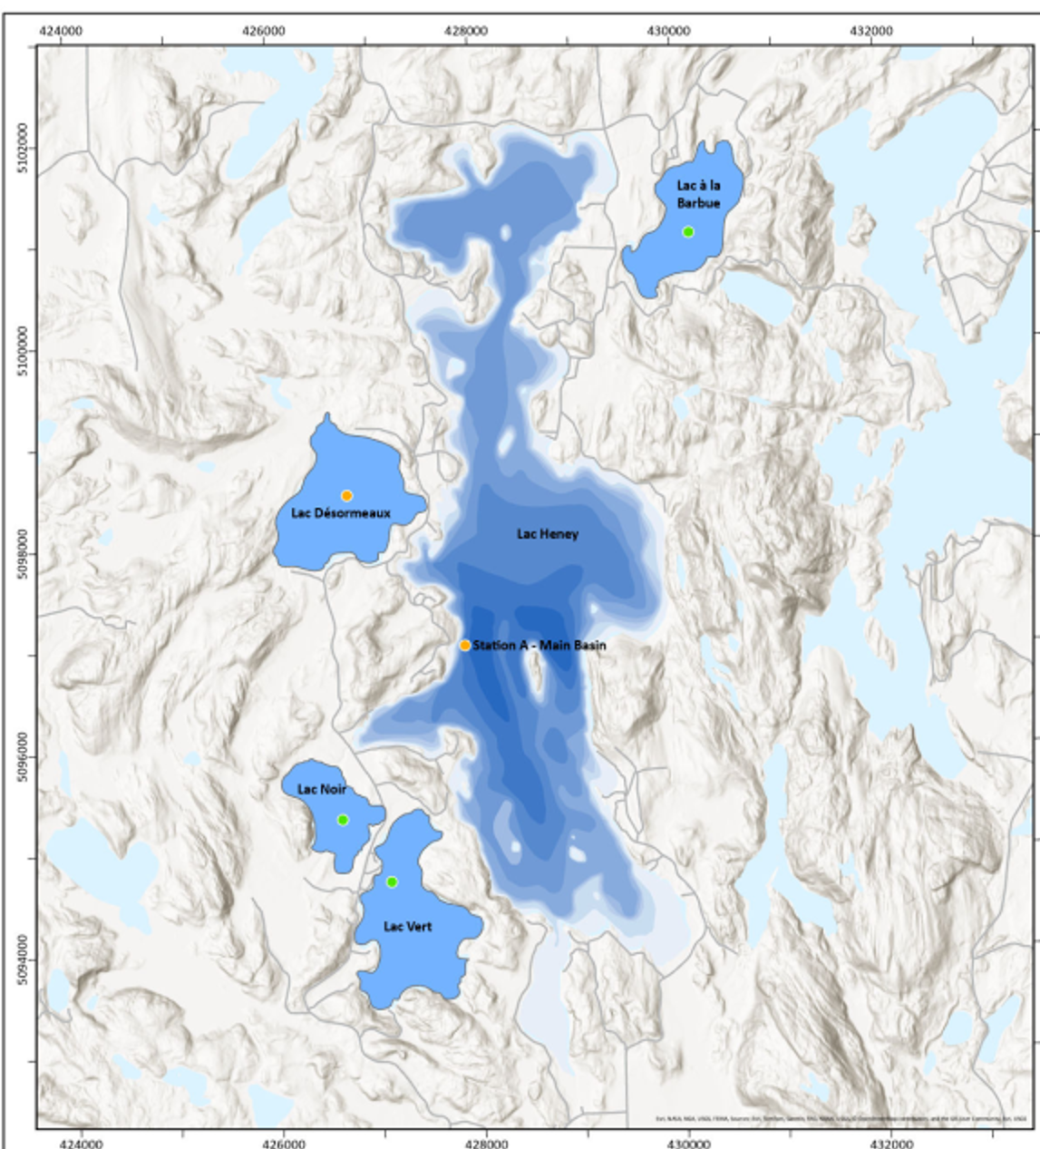
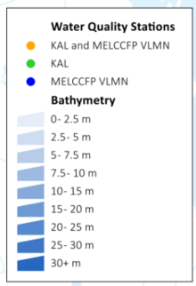
2025/26 Sampling Program
Kilgour & Associates
  Heney & 4 watershed lakes.
  Spring, summer, and fall samples
  Total Phosphate (TP), Dissolved Oxygen (DO), Secchi disk, and temperature.
  ABVLH (TM/CL)
    Monthly sampling of temperature and dissolved oxygen
    Secchi Dish (Transparency)

Slide 23
Total average phosphorus concentration (µg/L)
Lac Heney, 1998 to 2025
2025 TP Avg = 11.9 ug/L
Treatment Dec 2007

Slide 24
Heney Lake Phosphorus Concentration (ug/L)
Summer data have shown a continuous decrease in total phosphorus over the previous three years, however with a slight increase in 2025.
10.7 µg/L in 2022; 9.1 µg/L in 2023; 7.9 µg/L in 2024; 11.9 µg/L in 2025.
Total phosphorus measurements taken at the end of summer indicate a release of phosphorus from the sediments, linked to decreased oxygen levels.
Oxygen levels at the sediment surface, at a depth of 33 m, were not completely anoxic (approximately 1 to 2 mg/ml).

Slide 25
Average concentration of total phosphorus in the lakes of the watershed (2015 – 2025 µg/L)
The total phosphorus concentration in the tributary lakes has generally remained stable over time (general trend), despite significant annual variability.
Lac Vert is an exception: average concentrations there have generally decreased between 2015 and 2025.
Lac Vert
Lac a la Barbue
Lac Desormeaux
Lac Noir

Slide 26

Average concentration of total phosphorus in the watershed lakes (2025 µg/L)
Average TP ug/L 2025
Lac Désormeaux 24.0
Lac à la Barbue 17.0
Lac Noir 15.0
Lac Heney 11.9
Lac Vert 9.0
EUTROPHIC
MESOTROPHIC
Mesotrophic
OLIGOTRPOPHIC
Oligotrophic

Slide 27
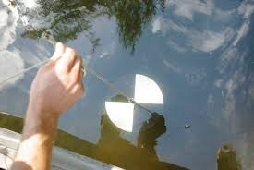
Water clarity measurements using a Secchi disk (depth in meters)
 | Spring | Summer | Late Fall | AVG 2025 | AVG 2024
Lac Heney | 1.8 | 3.0 | 2.0 | 2.3 | 4.8
Lac Vert | 1.9 | 7.0 | 3.6 | 3.4 | 3.4
Lac Noir | 3.0 | 4.0 | 2.0 | 3.3 | 3.0
Lac à la Barbue | 1.8 | 5.0 | 2.0 | 2.9 | 3.0
Lac Desormeaux | 1.8 | 3.0 | 2.0 | 2.3 | 2.1
The depth measured by the Secchi disk allows us to assess turbidity (water transparency), which depends on many factors such as algae, phytoplankton, and suspended sediments.
Generally, clearer water means cleaner, healthier water.
Lake Heney experienced a decrease in transparency in 2025.

Slide 28
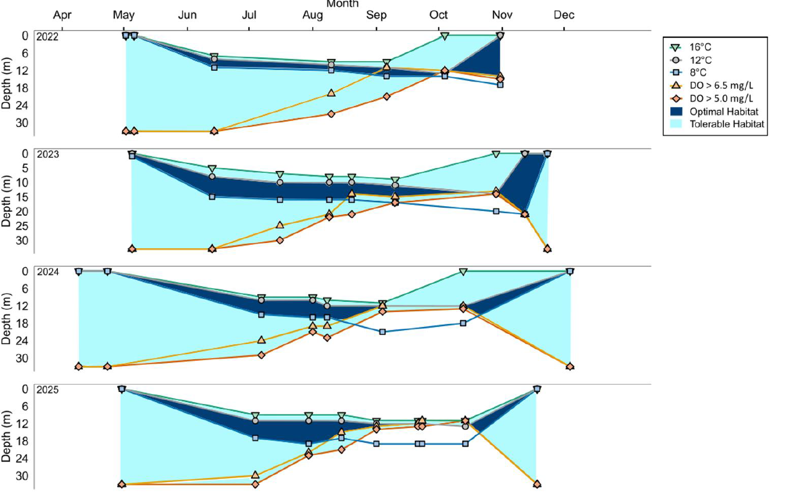
Habitat for lake trout 2022 to 2025
The dark blue areas indicate optimal habitat for lake trout (water between 8 and 12°C and oxygen above 6.5 mg/L).
The light blue areas indicate suboptimal habitat (oxygen level above 5.0 mg/L).
Note: Lake trout can survive at an oxygen level of 4 mg/L.
2022
2023
2024
2025

Slide 29
Next steps
2026 Monitoring Program
Continue spring, summer, and fall watershed monitoring by Kilgour Association, funded by the Foundation.
ABVLH will continue monthly monitoring of dissolved oxygen, temperature, and clarity (by Lake Association members).
Support the Quebec RSVL (Voluntary Lake Monitoring Network) program. RSVL will monitor Lake Heney three times in 2026.

Slide 30
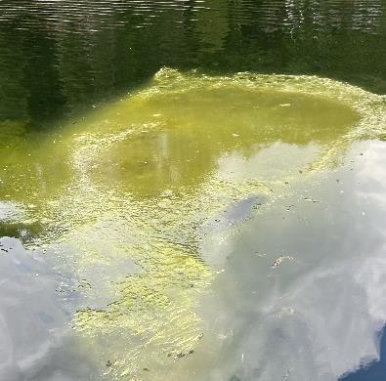
Phosphates in Lakes Promotes ALGAE GROWTH
Algae may result in harmful algal blooms, Blue-green algae and cyanobacteria which can have severe impacts on human, animal and aquatic health
19 years after the FeCI3 treatment in 2007, we continue to
see a variety of algae blooms in Lac Heney & Lac Desormeaux
during the summer
Health Effects of Contact with Harmful Algae
skin irritation
respiratory effects
gastroenteritis (vomiting, fever, diarrhoea)
blue-green algae can produce toxins fatal to animals, and has been connected to fish kills, and the death of dogs
Lac Heney - June 2023

Slide 31
A Lake is Only as Healthy as its Shorelines
Your protection of the shoreline is mandatory (MRC Regulation) and critical to protect the water quality of our lakes!
Protects against soil and shoreline erosion
Provides a barrier against sediment input to the lakes
Acts as a filter against added nutrients (Phosphorus)
Acts as a regulator of the hydrological cycle (water cycle)
Provides a habitat for fauna and flora

Slide 32
Just Say No To Lawns
Give yourself a break from another menial task at the cottage and minimize your lawn
Convert your lawn to dwarf clover that doesn’t require fertilizer or mowing
Lawns attract geese and ducks, their feces ruin the water quality: E-coli contaminates the water, causes swimmers itch, ruins your dock
Lawns don’t preclude water run-off as well as native plants

Slide 33
Property Owners’ Action List
  Ensure septic systems are up to code and operating correctly
  Reduce water volumes going into septic tanks (space out laundry and DW loads)
  Revitalize shoreline planting, minimize lawn area
  No phosphate products (no TSP for deck cleaning, no P fertilizers)
  Prop wash and boat wakes, especially in shallow water & when close to shore disturbs sediments
    When sediments are disturbed, the bound phosphorus is released back into the water to be picked up by more plants and algae
  Keep campfires away from the shoreline and especially rocky outcrops.
  Dispose of fire ash in garbage or far from the lake
  If cutting/removing weeds remove them from the lake and place far from the shore.
  Residual milfoil weed cuttings easily propagate and results in more weeds throughout the lake

Slide 34
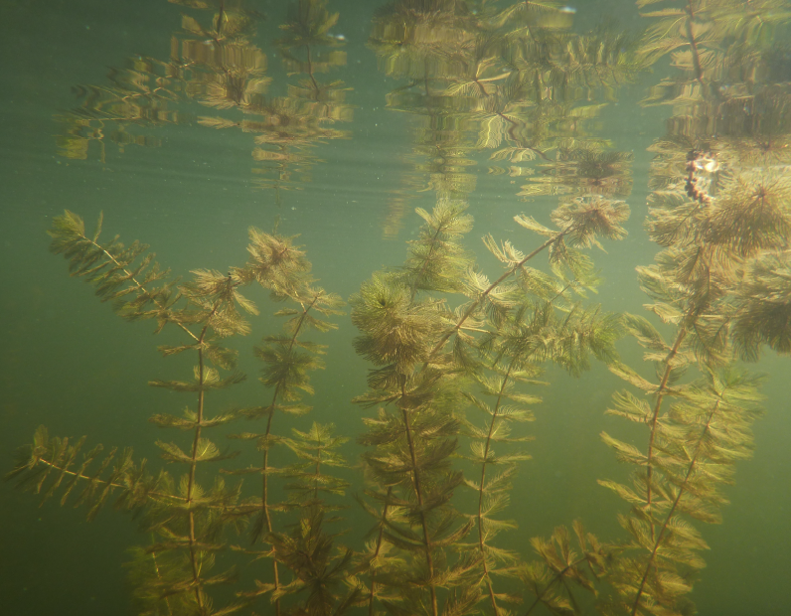
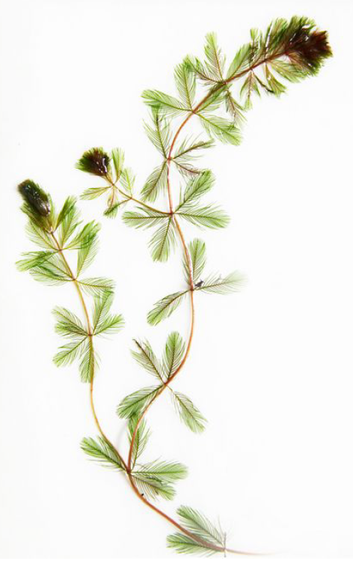
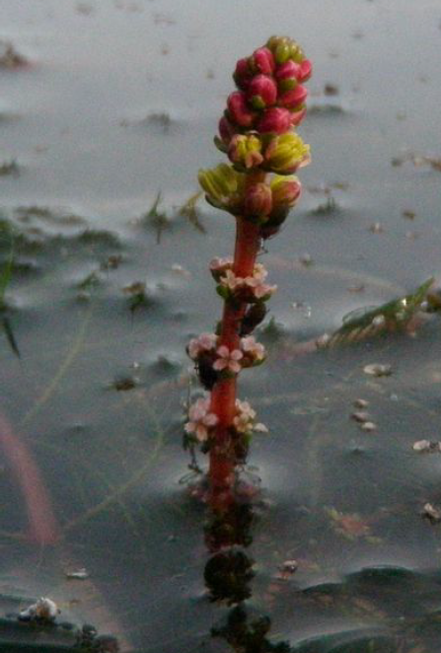
Eurasian Milfoil – Invasion of Lacs Heney and Desormeaux

Slide 35
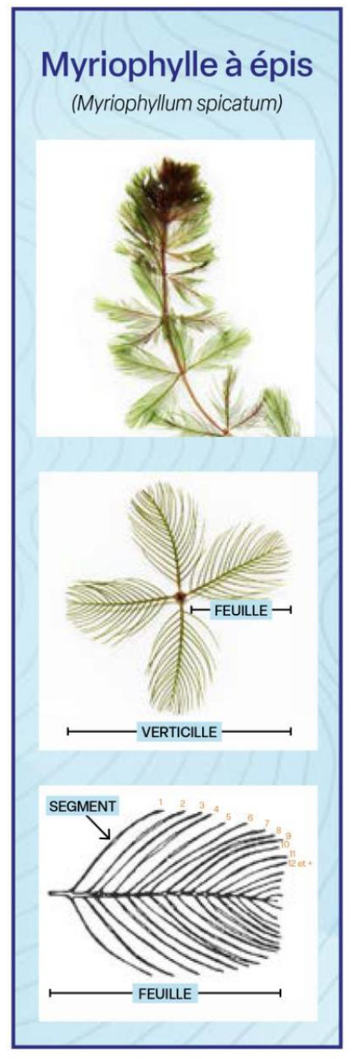
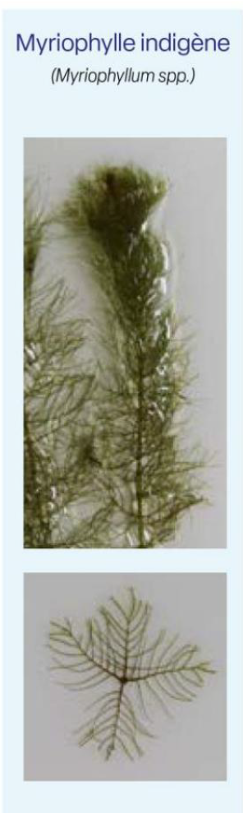
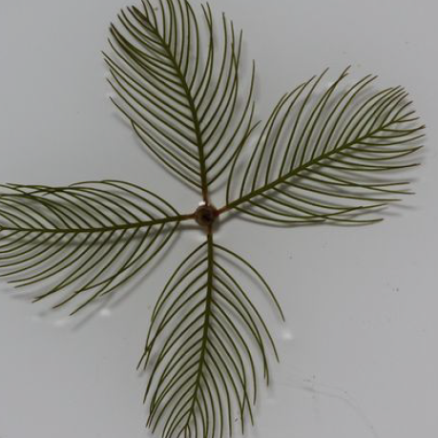
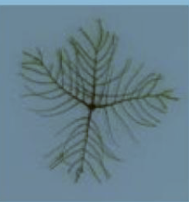
Eurasian Milfoil
Northern (Native) Milfoil
High number of pairs of leaflets (12-18)
Fewer pairs of leaflets (3 - 8)

Slide 36
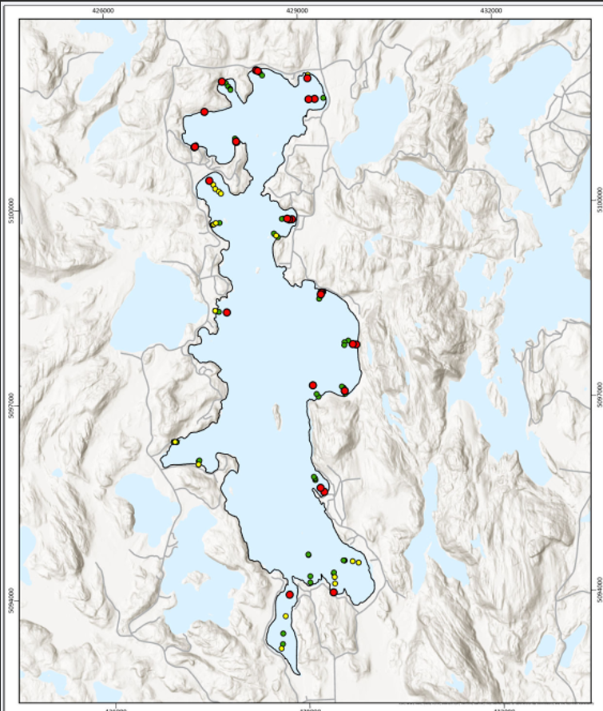
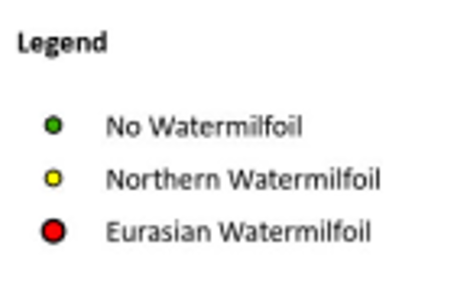
Presence of Water Milfoil in Heney Lake

Slide 37
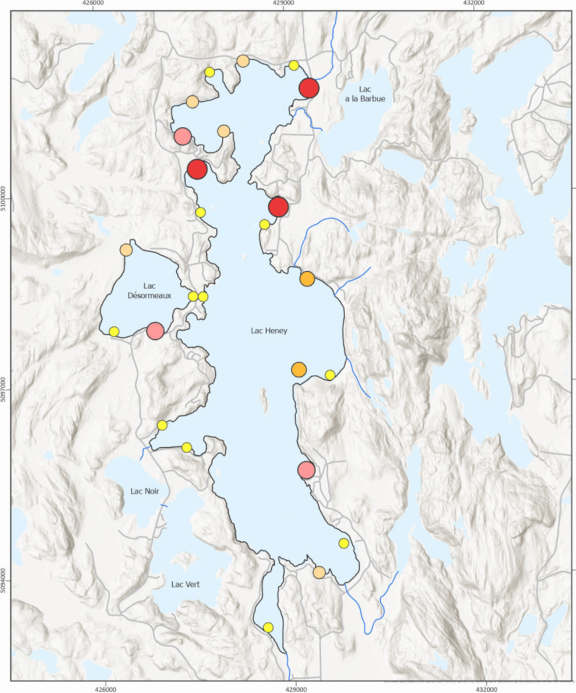
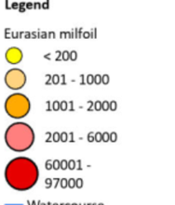
Concentration (g ww/m2) Eurasion Milfoil per Transect

Slide 38
Eurasian Milfoil Control Methods
No Authorization Required (<75 Sq. Metres; 807 Sq. Ft)
Manual Removal by hand
Installation of Benthic Barriers
(Tarpaulins i.e. Jute, Geotextiles, Typar)
Authorization and Permits Required (>75 Sq. Metres, 807 Sq. Ft)
Mechanical Removal
Removal using divers and suction equipment
Herbicides (Procellar) - Not approved in Quebec

Slide 39
Eurasian Milfoil - Next Steps
Formed committee to study & manage this issue
Education Plan, Boat Washing, Marker Buoys for areas to Avoid
Connect with other Associations to learn from
their experience (Lac Blue Sea, Lac des Cedres, Lac Edja)
Identify companies with experience (ABV7, FYTO, etc)
Obtain Cost Estimates; Preliminary est. $200-$500,000
Research and apply for government grants
NEED FOR COMMUNITY SUPPORT

Slide 40
Eurasian Milfoil – Personal Actions
Boat, Canoe, Kayak & Trailer Washing when moving boats between lakes (free boat wash stations at LSM boat launch & Gracefield behind the library)
Pressure wash with hot water
Avoid areas of weed beds
Remove weeds from shoreline and dispose far from shore
Install personal tarps (<75 Sq. M) in the spring, remove and wash in the fall

Slide 41
Bay Captain Update
Bay Captains: Building a Stronger Lake Community
The ABVLHW Bay Captain Program strengthens communication across the watershed.
The program helps keep residents informed, connected, and engaged.
Bay Captains foster community spirit and support stewardship of the lake.

Slide 42
Bay Captain Update
What Bay Captains do:
Communicate with property owners in their bay area.
• Gather feedback and stay connected with local concerns and ideas.
• Serve as a liaison between residents and the ABVLHW Board.
• Share Association updates and relay residents’ concerns, questions, and suggestions.
Volunteer opportunities:
Most Bay Captain positions have been filled thanks to community volunteers.
Current vacancies:
  • McInnes Road – west side of the lake
  • Central East Side – Ch. Oyen south to the end of Ch. Du Lac Heney
Interested volunteers can contact Jane or Ashwin.

Slide 43
Bay Captain Update
Bay Captains help keep neighbours informed about:
  • Mining claims
  • The spread of Eurasian milfoil
  • Watershed and environmental concerns
  • Community events, including the AGM and post‑AGM BBQ
Residents are encouraged to engage with their Bay Captain when contacted.

Slide 44
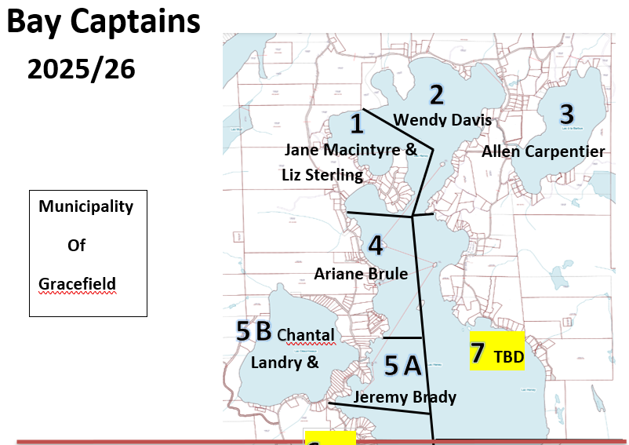
Bay Captain Update

Slide 45
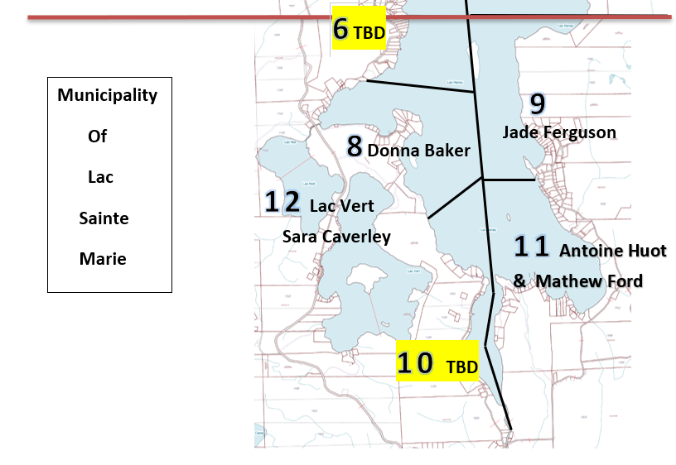
Bay Captain Update

Slide 46


HOW TO FIND US
www.facebook.com/lacheneyQC
www.bvlacheney.ca

Slide 47
Thank you!

