Slide 1
2023
Annual General Meeting
Bassin versant du Lac Heney Watershed
Location: Lac-Sainte-Marie Community Centre, 2nd floor
10-B rue du Centre, Lac-Sainte-Marie
Sunday, July 23 2023

Slide 2
Agenda - Foundation
Foundation President’s Report Tom McKenna
Nomination Committee Tom McKenna
Foundation Financials Chantal Proulx

Slide 3
Foundation President’s Report
Tom McKenna

Slide 4
Foundation Nomination Committee
Tom McKenna

Slide 5
Foundation Financials
Chantal Proulx

Slide 6
Agenda – Bassin versant du Lac Heney Watershed
Registered as the Association for the Protection of Lac Heney
Association – President’s report Roger Larson
Nominating Committee Tom McKenna
Association Financials Ted Billey
By-Law Amendment Tony VanDuzer
Communications - 3E: Engage, Educate & Enlighten Christine Ouellette
Membership Tony VanDuzer
Science - State of the Lake Tom McKenna
Environment Chantal Landry
Merchandise Diane Billey
Bay Captains Roger Larson

Slide 7
Association President’s Report
Major activities during the past year include:
  Association Committee restructuring
    Science & Environment expanding critical science assessments - phosphorus, nitrogen, sediment, mass balance
    Communications moved on-line - plan is three electronic newsletters per year & targeting increased website traffic
    Membership - database for members and residents, new challenge – availability of email addresses
  Scientific assessment of the water quality trends for the five major watershed lakes, including mass balance
    Lake total phosphorus results for 2022 back to previous trends with Heney stabilizing around 10 ppm
      2021 looks to be an anomaly, Could be impact from 2021 forest fires
  Increased community & membership engagement
    Community Science Project - Milkweed protecting shorelines
    Island signage to help protect the islands from misuse
  Municipal relations - MRC de la Vallée de-la-Gatineau, Municipalité de Lac-Sainte-Marie and Ville de Gracefield
    June 27 meeting with Gracefield maire Matthew Caron, Directrice général Julie Jetté, & adjoint DG Julie Therrien
      Septic systems, invasive species - boat wash for Heney fire station
      Water quality - Heney & RSVL programs to monitor phosphorus
      Shoreline protection during development & restoration of shores
      National Forum on the Lakes: CRE Laurentides (Laurentian Regional Environmental Council) - resources available to municipalities
      Wildlife control - beaver dams and water levels – controversial wildlife issues

Slide 8
Association President’s Report
New Challenges
  Stewardship
    Sediments, septic systems, and shorelines
  How do we build engagement when there is no immediate crisis?
    Rebuilding watershed membership (2022 membership at 124)
    Bay Captains – looking for a coordinator
  Boat launch availability
    Board established task force in 2020, but no consensus on needs & role of the association to address issue
      Private services continue to be available, but for how long?
      What can we learn from GF&GC experience?
      What does the boat wash at the fire hall imply?
        Municipal action?

Slide 9
Association Nominating Committee Report
Board of Directors for 2023/24 - Association for the Protection of Lac Heney
Directors, continuing Lake First Term Elected End
* Diane Billey Heney 2019 2025
* Chantal Landry Desormeaux 2019 2025
* Sean Sutton Desormeaux 2017 2025
* Karen Richardson Heney 2023 2025
* Christine Ouellet Heney 2023 2025
* Tony VanDuzer Heney 2021 2025
* Michael Wolfson Heney 2015 2025
** Roger Larson, President (2015) Heney 2018 2022
** Tom McKenna Heney 2004 2022
** Rock Radovan Heney 2016 2022
** Ashwin Shingadia Heney 2012 2022
** Liz Stirling Heney 2020 2022
** Ted Billey Heney 2018 2022
* Indicates Directors elected for 2-year terms ending in 2023
** Indicates Directors standing for election in 2022, for 2-year terms ending in 2024
We encourage representation from all watershed lakes!
We encourage diversity on our Board!

Slide 10
Nominating Committee: Motions
Moved by Nominating Chair, Tom McKenna:
To re-elect the Directors standing for re-election in 2023 for two-year terms ending in 2025
  Diane Billey Heney Chantal Landry Desormeaux
  Sean Sutton Desormeaux Tony VanDuzer Heney
  Michael Wolfson Heney Karen Richardson Heney
  Christine Ouellet Heney
To elect members who wish to come forward to serve on the Board of Directors
  Name __________________
  Name __________________
  Name __________________
  Name __________________

Slide 11
Association Financials
Income Statements- 2021 & 2022 / 2023 Budget
Ted Billey, Treasurer
Audit Committee: Tony VanDuzer & Liz Stirling

Slide 12
2021 Income Statement: December 31
Bassin versant du Lac Heney
Notes:
The Association presently has merchandise inventory on hand with a purchase cost of $3,664.93
This inventory has a projected value of $5,248.75
(BVLH revenue = Retail sale price less Merchant cut)
This statement reflects an “Accrual” view of the year, depicting the expenses and revenues associated with the year in which they were earned, and not necessarily when they were invoiced, or deposited.

Slide 13
2022 Income Statement: December 31
Bassin versant du Lac Heney
Notes:
The Association presently has merchandise inventory on hand with a purchase cost of $2,990.88.
This inventory has a projected value of $4,250.00 ( BVLH revenue = Retail sale price less Merchant cut )
This statement reflects an “Accrual” view of the year, depicting the expenses and revenues associated with the year in which they were earned, and not necessarily when they were invoiced, or deposited

Slide 14
2023 Budget
Notes & Assumptions
  Membership growth of 10%
  Foundation Supports 100% of Ms. Claus Honorarium
  Foundation Supports 50% of Forum nationale sur le lacs 2023

Slide 15
Association Financials: Motions
The financial statements were independently reviewed by the Audit Committee (Tony VanDuzer & Liz Stirling) and were accurate in all material respects, and were approved by the Board:
  Moved by Tony VanDuzer & seconded by Liz Stirling:
    That the income statements dated December 31, 2021 and 2022, as prepared by the Treasurer, be approved as presented.
The Budget for 2023 as prepared by Treasurer Ted Billey and approved by the Board of Directors:
  Moved by Treasurer Ted Billey:
    That the Budget for 2023 be approved as presented.

Slide 16
Bassin versant du Lac Heney Watershed
By-laws revisions
Tony VanDuzer
Minimum Board size reduced to 8, maximum remains at 20
Remove immediate past president as ex-officio member of Board & Nominating Committee
Change fiscal year end to April 30
Provide for single signature cheques for amounts up to $1,000
Flexibility to add designated signing officers
Renaming the Audit Committee to Accounting Review Committee

Slide 17
Bassin versant du Lac Heney Watershed
By-laws revisions
  Moved by Tony VanDuzer & seconded by Liz Stirling:
    The amendments to Revised By-law Number One of the Association in the form attached to the Notice of Annual Meeting be approved.

Slide 18
Communication
Communication : Christine Ouellette

Slide 19
3E: Engage, Educate & Enlighten
Ongoing education efforts continue through posting to our website https://bvlacheney.ca
  “Did You Know” series and videos.
  Suggestions for future DYK messages or videos are always welcome
Water sampling reports & results are posted on our website and displayed in our kiosk
Supporting membership growth by showing the value of the association and providing tangible information about our watershed.
Bird watching/counting via eBird technology
  Encouraging our membership to pay attention to the natural ecosystem by submitting bird counts to a global data network. Free to download and a fun family activity.
Water monitoring ride-along
  Join the science committee during a monthly water sampling event to understand how it works and why it is important.
  Postponed due to physical distancing challenges.

Slide 20
Kiosk & Community Outreach
Our Kiosk, Website and Facebook page are our main tools for reaching the community
  Kiosk updated 1-2 times a year
Web (www.bvlacheney.ca) and Facebook used for quicker and shorter communications
Kiosk materials also available on website under the “Watershed” tab.

Slide 21
Comité d'adhesion
Tony VanDuzer
En 2020, nous avions plus de 170 membres - mais le nombre de membres est tombé à moins de 120 pendant la COVID
La reconstruction de l'effectif est une priorité
  L'adhésion à l'Association soutient ses activités et vous donne une voix dans ce que nous faisons
  Avec plus de membres, nous sommes mieux placés pour défendre vos intérêts
Stratégies de reconstruction
  Élaboration d'une liste maîtresse consolidée des membres, des anciens membres, des abonnés aux e-mails du site Web et de certains autres propriétaires au bord du lac
  Travailler avec le comité des communications pour solliciter de nouveaux membres
  Par exemple. via des newsletters trimestrielles
  Travailler avec les capitaines de baie
  Processus de rationalisation pour les membres existants à renouveler et les nouveaux membres à rejoindre via www.bvlacheney.ca

Slide 22
Science & Environment Committee
State of the Lake: July 2023
Tom McKenna
Summary 2022 Water Quality Monitoring

Slide 23
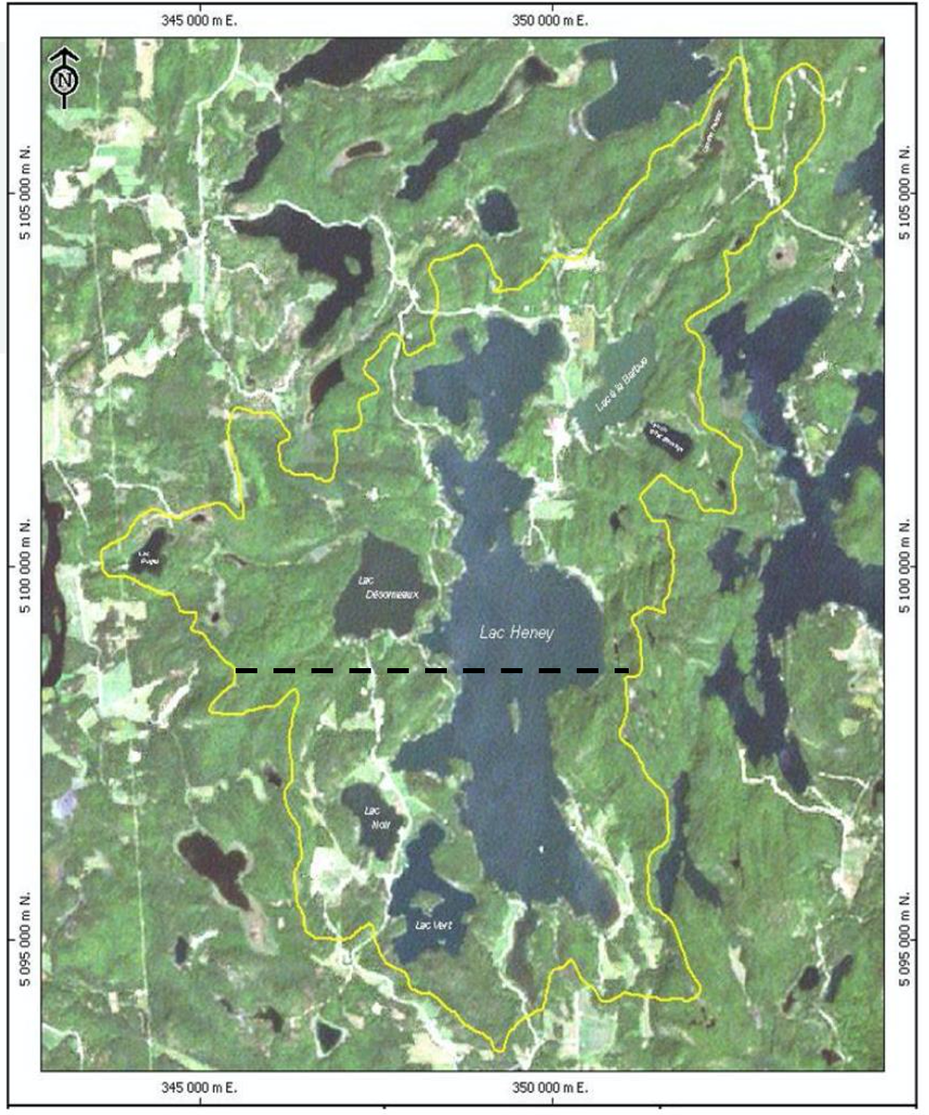
Bassin versant du Lac Heney
Côté Gracefield
Lac à la Barbue
Lac Desormeaux
Lac du Chat Sauvage
Côté Lac-Sainte-Marie
Lac Vert
Lac Noir
Lac Long
23

Slide 24
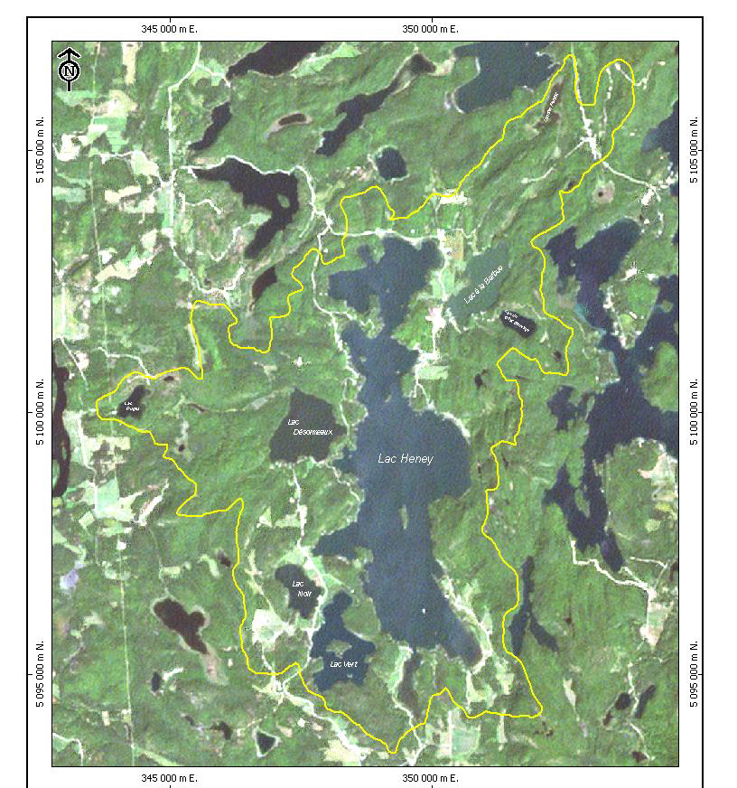
Chronology of Events
1993: Fish farm secures $1M grant from Gov’t of Quebec
1995: Lac Heney assessed at high risk due to Phospohorus
1999: Closure of Fish Farm ordered by Gov’t of Quebec
2000: GQ continuance ($ 3-4 million) to the fish farm
2001: GQ continuance ($ 4-5 million) to the lake association
2003: Comité paritaire formed (MDDEP – Lake Association)
2003-2006: Research, feasibility study on lake treatment
Nov. 2007: Lac Heney treated with FeCI3 ( 1st in the world ! )
2008-Present : Monitoring the effects of FeCl3 Treatment

Slide 25
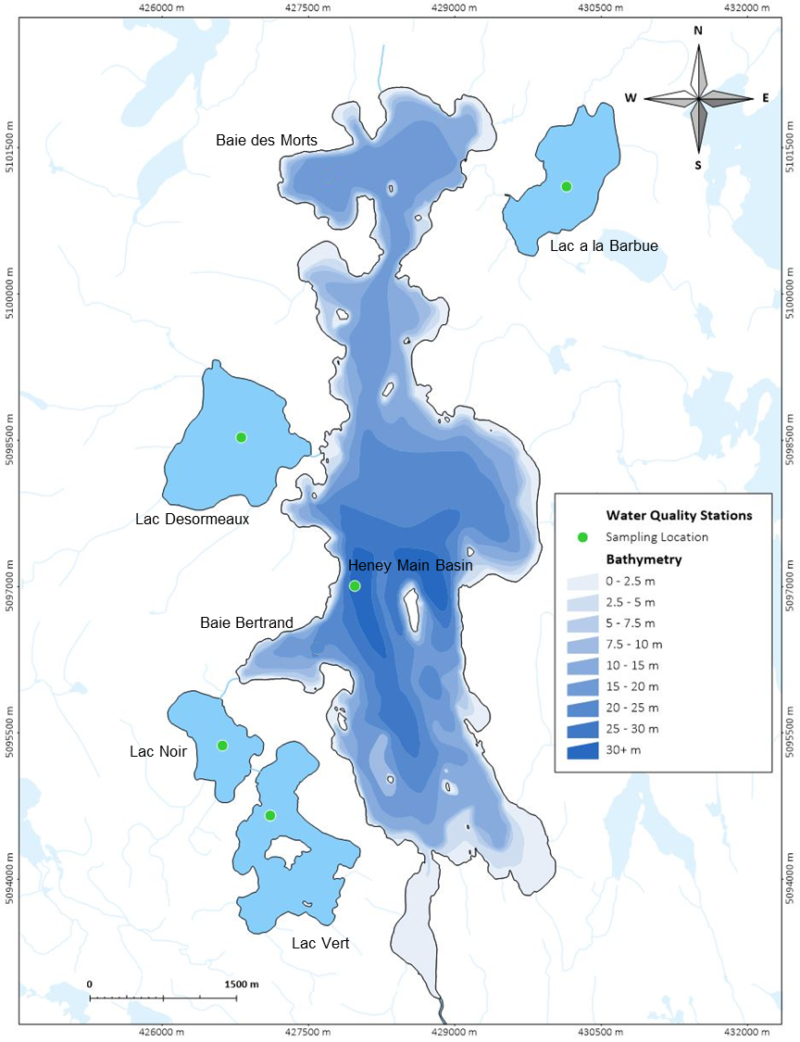
2021 Sampling Details & Locations
Kilgour & Associates
  Heney & 4 Watershed Lakes
    Summer & Fall water sampling of TP, DO, Secchi Dish & Temperature
    Sediment investigation of FE:P ratio
  ABVLH (TM/CL)
    Monthly monitoring of T, DO and Secchi Dish
    Participation in RSVL Quebec program
    Three events of TP, chlorophyll a, organic carbon

Slide 26
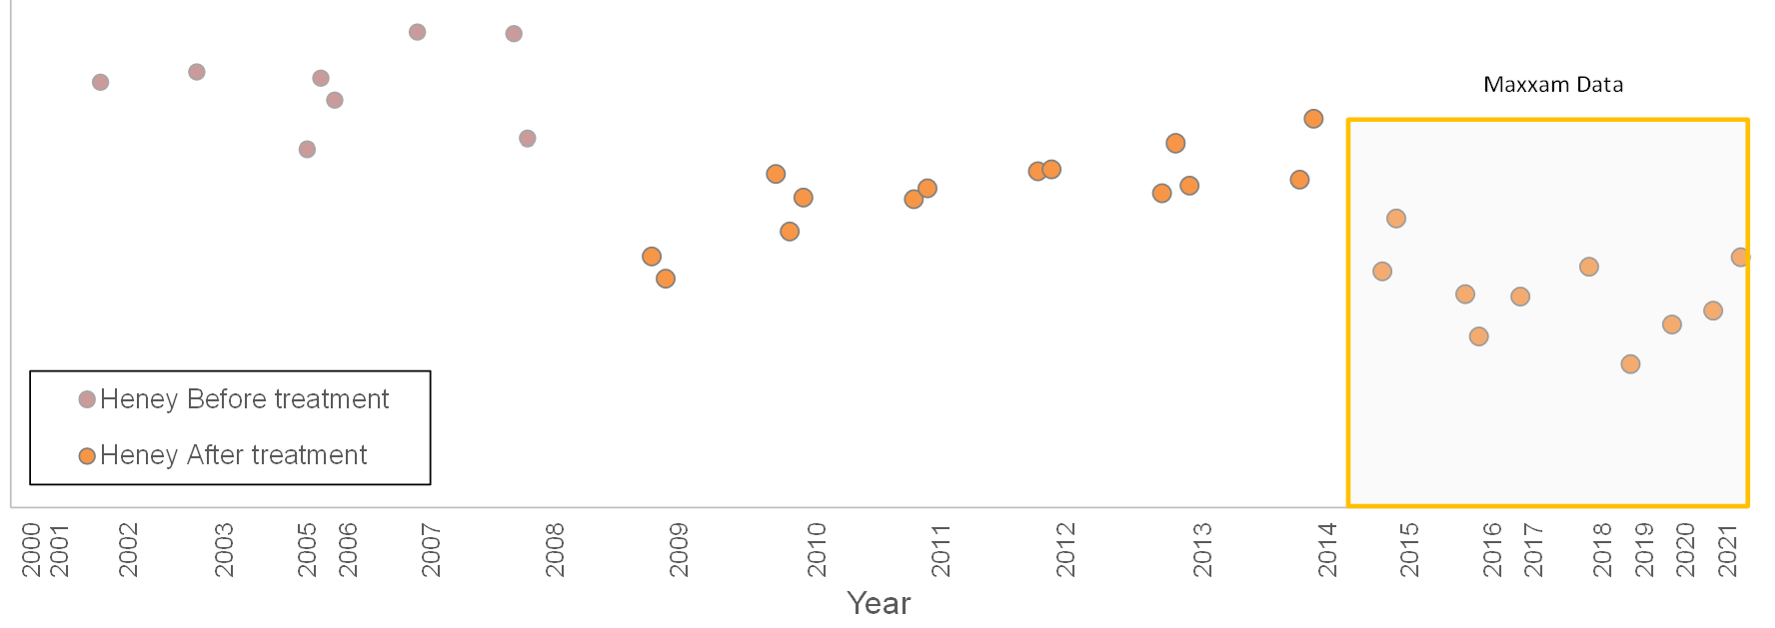
Lac Heney Phosphorus Concentration (ug/L)
Average Total Phosphorus Concentration (ug/L) - Fall Turnover 1998 - 2021
2021 TP = 13.7 ug/L
TP in 2021 was higher than in the last 6 years.
2021 was a year of extensive forest fires in the north.
Smoke from fires can contribute significant loads of Phosphorus to surface waters.
Numerous reports of excess algae growth in surface waters in the Ottawa region in 2021
EUTROPHIC
25
Mesotrophic
20
MESOTROPHIC
15
10
Oligotrophic
OLIGOTROPHIC
Lake Health can be classified into 3 categories.
1. Eutrophic (Phosphorus: 24 – 96 µg/L) Eutrophic lakes have high levels of nutrients and biological activity and are dominated by aquatic plants or algae. An environment that is too rich with nutrients can result in harmful algae blooms, dead zones and fish kills.
2. Mesotrophic (Phosphorus: 12 – 24 µg/L) Mesotrophic lakes (like Heney) have medium levels of nutrients, fairly clear water with beds of submerged plants.
3. Oligotrophic (Phosphorus: 0 – 12 µg/L) Oligotrophic lakes have few nutrients, low levels of algae, clear waters and excellent drinking water quality.

Slide 27
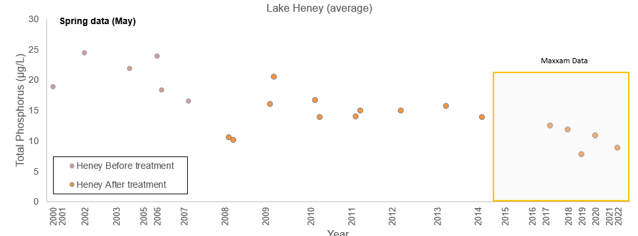
Lac Heney Phosphorus Concentration (ug/L)
Average Total Phosphorus Concentration (ug/L) - Spring Turnover 1998 - 2022
2022 TP = 8.8 ug/L

Slide 28

Watershed Phosphorus Concentration ( 2021 ug/L)
Average TP ug/L
Lac à la Barbue 25.8
Lac Desormeaux 17.8
Lac Noir 16.1
Lac Heney 13.7
Lac Vert 12.6
EUTROPHIC
Mesotrophic
MESOTROPHIC
Oligotrophic
OLIGOTROPHIC

Slide 29
Whole Lake Average
Total Phosphorus Concentrations (µg/L)
Lac à la Barbue
Lac Desormeaux
Lac Vert
Lac Noir
Lac Heney

Slide 30
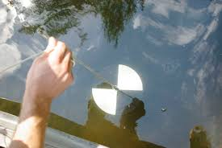
Water Clarity – Secchi Disc Depth ( meters )
 | Spring | Summer | Late Fall
Lac Heney | 3.0 | 4.1 | 3.5
Lac Vert |  |  | 2.2
Lac Noir |  |  | 1.8
Lac à la Barbue |  |  | 1.8
Lac Desormeaux | 1.8 | 3.0 | 2.0
Secchi disc depth measures turbidity (water clarity) which is dependent on numerous factors such as algae, phytoplankton and suspended sediment.
In general, higher water clarity is associated with cleaner, healthier water.
2021 Lac Heney has seen improvement to depths of 4 - 6 M.

Slide 31
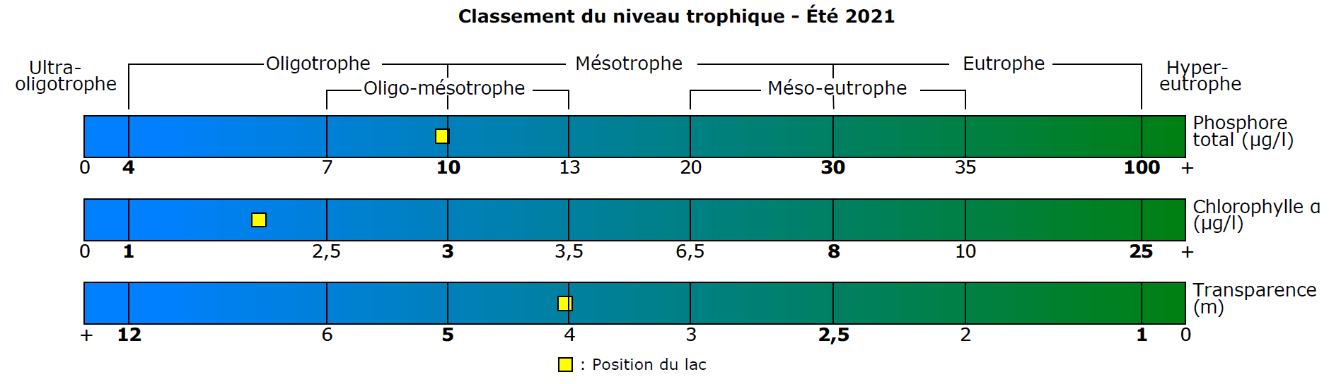
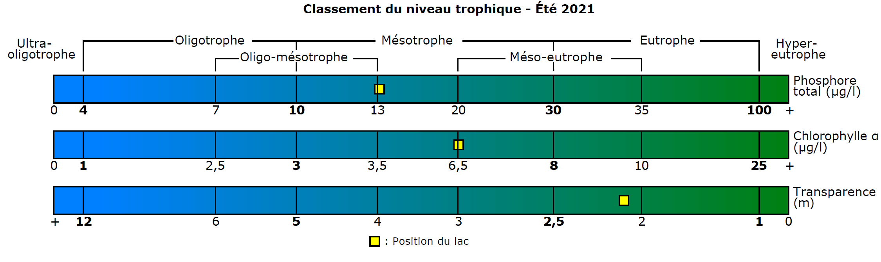
Water Quality in Watershed Lakes
Heney Lake
Total Phosphorus (ug/L)
Lac Desormeaux
Total Phosphate (ug/L)

Slide 32
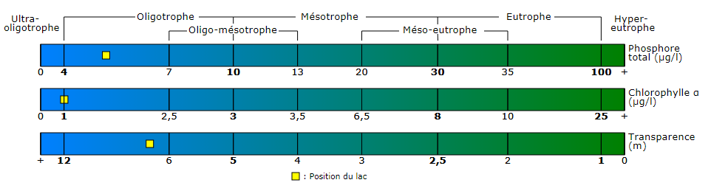
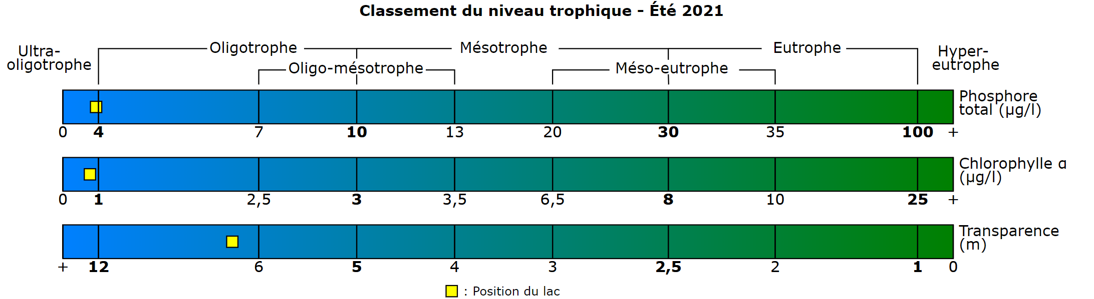
Water Quality in Nearby Lakes
Lac Pemichangan – Suivi de la qualité de l’eau 2019 (RSVL)
Total Phosphorus (ug/L
4.8
Lac des Trente-et-un-Milles – Suivi de la qualité de l’eau (RSVL)
Phosphate Total (ug/L
3.7
Lac Heney 13.7 ug/L (2021)

Slide 33
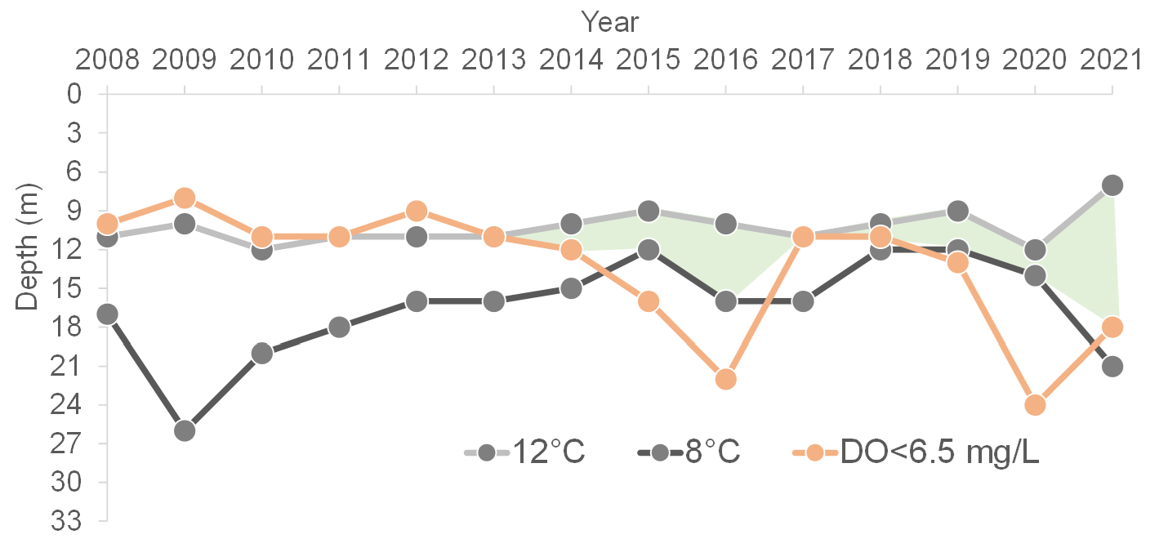
Lake Trout Habitat 2021 - Improving
Optimal lake trout habitat is in water between 8-12⁰ C and oxygen greater than 6.5 mg/L
Winter fishing for lake trout is illegal throughout the province. Regardless, several trout were caught on Heney this past winter.
The Association engaged the game wardens to regularly patrol the lake.
People have been fined!

Slide 34
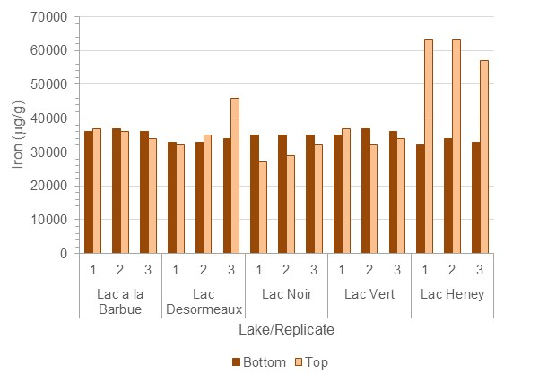
Watershed Sediment Analysis
Historical iron levels in lake sediments (darker bars) were around 35,000 ug/g.
In Lake Heney, the iron addition resulted in enrichment of iron in surficial sediments (lighter bars).
The numbers 1, 2, 3 indicate replicate samples collected from each lake on the same day.

Slide 35
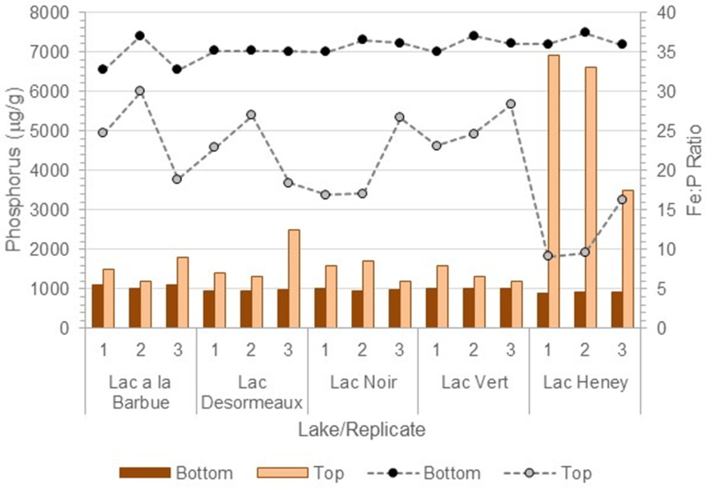
Watershed Sediment Analysis
Historical (darker bars) and surficial (lighter bars) P levels in sediment.
The dotted line at the top with black circles indicate the historical ratio of Fe:P. The grey dotted line with grey circles indicates the current ratio of Fe:P.
Fe:P values < 10 have an elevated risk of P release from sediments into the water.
Fe:P values > 15 have a reduced risk of P release
In Heney, the Fe:P ratio is < 10 in 2 of 3 samples,
indicating a risk of P release to overlying water. This phenomenon is occurring in Heney.

Slide 36
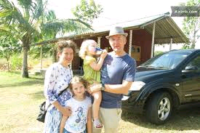
Phosphate Production per Residence (estimated)
The calculation below estimates the amount of phosphate a ‘typical’ lake residence introduces
into the lake each year
3 grams per person per day (on average)
X family of 4
X 100 days/year (weekends)
= 1.2 kg phosphate/year/family
X 375 chalets on lac Heney …
= 450 Kg/year
We need to be vigilant!

Slide 37

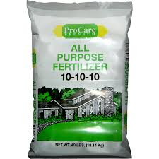

Phosphate Sources
Certain garden and grass fertilizers
Certain domestic cleaning agents
(TSP/Tri-Sodium Phosphate)
  TSP is found in some cleaning agents, lubricants, food additives and other household products. TSP has declined owing to ecological problems with the damage to lakes and rivers through eutrophication.
Septic system discharge
Human and animal waste
Ashes from outdoor fires (runoff) and from fireplaces.
10-10-10
10 kg bag ~ 5 Kg of P

Slide 38
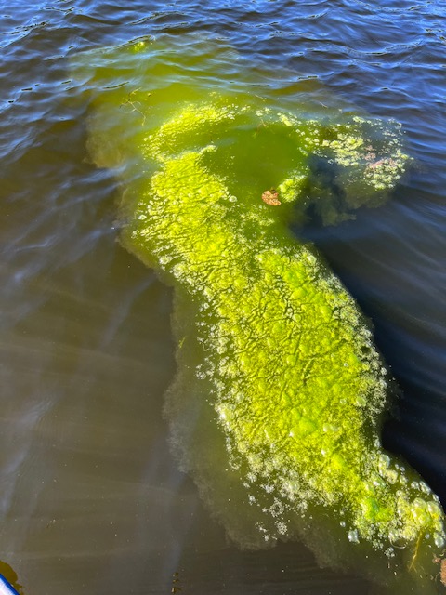
Phosphates in Lakes = ALGAE GROWTH
Algae may result in harmful algal blooms Blue-green algae and cyanobacteria can have severe impacts on human, animal and aquatic health
15 years after the FeCI3 treatment in 2007, we continued to see a variety of algae blooms in Lac Heney & Lac Desormeaux in the summers of 2021 and 2022.
The Bloom pictured was photographed in July 2022 in Lac Desormeaux
Health Effects of Contact with Harmful Algae
skin irritation
respiratory effects
gastroenteritis (vomiting, fever, diarrhoea)
blue-green algae can produce toxins fatal to animals, and have been connected to dog deaths and fish kills
July 2022

Slide 39
Property Owners’ Action List
  Ensure septic systems are up to code and operating correctly
  Reduce water volumes going into septic tanks
  Revitalize shoreline planting, minimize lawn area
  No phosphate products (no TSP for deck cleaning, no P fertilizers)
  Minimize boat wakes, especially when close to shore
    Phosphates bind to soil and rocks or sediment and when disturbed by boat wakes, it is released back into the water to be picked up by more plants.
  If cutting weeds remove them from the lake and place far from the shore. Residual weed cuttings easily propagate and results in more weeds throughout the lake.
  Keep campfires away from the shoreline and especially rock outcrops. Dispose of fire ash in garbage or see Cottage Life suggestions
  What is the best way to dispose of ashes from the fireplace? | Cottage Life

Slide 40
Next Steps
2022 Monitoring Program
Continue watershed monitoring in the spring, summer and fall
Repeat sediment analysis of watershed lakes
Perform additional QA/QC (quality accuracy and quality control) testing in late summer
Continue monthly monitoring of dissolved 0₂, Temp. and clarity (by Lake Assoc. members)
Continue the Quebec RSVL Program. (Réseau de surveillance volontaire des lacs – performed by Lake Association members).
RSVL Monitors Total P, Temp, clarity, chlorophyll, 3 time/year. Allows comparison to lakes across the province (see slide 10)

Slide 41
Environment
A Community Science Project -- Milkweed protecting shorelines
- Chantal Landry
Overview of the wildflower project
Importance of the protection of the shoreline
Overview of the MRC Shoreline Regulations and related fines
Swamp milkweed, an example of natural vegetation of the shores

Slide 42
Merchandise
Merchandise: Diane Billey

Slide 43

Available at Beggar’s Bench

Slide 44
Bay Captain 2023 Report
With Elaine MacDonald’s departure from the watershed with the sale of their cottage, we are looking for a new Bay Captain Coordinator to continue building
Door Drop information package: bay captains and board members of the association delivered information packages in 2022.
The goal of this door drop project was to connect with all our neighbours in our community and share information on best practices to keep our lakes and environment healthy and our properties valuable.
We also need to collect & update emails from property owners with the intent of keeping our community connected while sending email communications a few times a year and sharing pertinent events.
Help all Bay captains continue their role of connecting annually with their neighbours on Lac Heney, Lac Desormeaux, Lac Vert, Lac Noir and Lac à la Barbue.
We are looking for other bay captains to join this committee. You must be willing to be in touch with your neighbours in a designated bay via email a few times a year and perhaps in person, once a year.

Slide 45


HOW TO FIND US
www.facebook.com/lacheneyQC
New www.bvlacheney.ca

Slide 46
Thank you!

